Slide 1

ASTROSAGE ANALYSIS
UTKARSH CHANDRA
05-09-2025

Slide 2

ABOUT ASTROSAGE
AstroSage is a leading astrology platform that provides a wide range of services such as personalized horoscopes, Kundli generation, compatibility matching, Vastu guidance, and live consultations with astrologers. Available both as a website and a mobile app with millions of users, it combines traditional Vedic astrology with modern technology to deliver accurate and accessible predictions in multiple languages.

Slide 3
PROBLEM STATEMENT
To optimize call center operations for AstroSage with a 1 crore investment.
The goal is to determine how to allocate this investment to maximize operational efficiency, customer satisfaction, and profitability.
This project will involve analyzing historical call data, performance metrics, and market trends to make informed decisions.

Slide 4
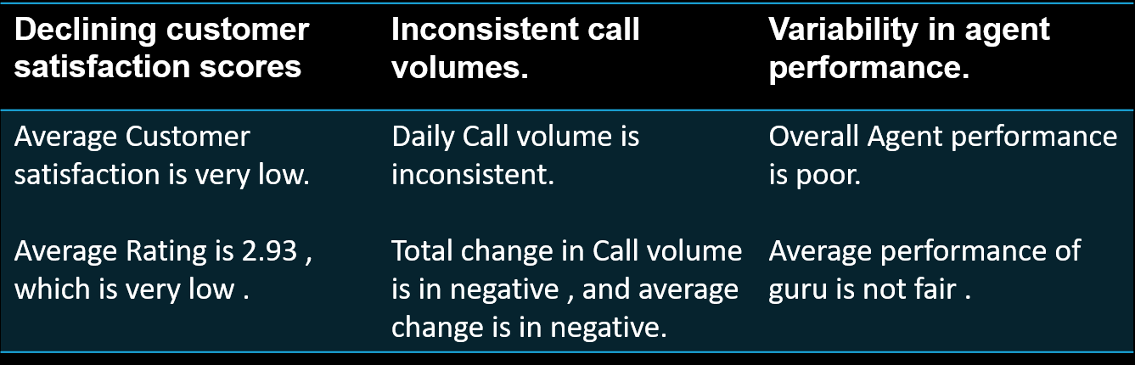
IDENTIFYING PROBLEM GAPS
AstroSage has been facing challenges in maintaining optimal call center performance.
As per given Data :

Slide 5
TRAFFIC WEBSITE
According to given data
Gurucool have more Traffic
Than app
User traffic Plateform
Gurucool
App
Dashboard

Slide 6
USER CALL STATUS
Insights
41% calls completed; 59% not successful.
No-answer (21%) and busy (15%) are key blockers.
Recommendations
Optimize call timing & add call-back option.
Improve network/agent handling for failed calls.
Use smart dialers to raise completion rates.

Slide 7
USER CHAT STATUS
Insights
Only 29% chats completed; 71% not successful.
Failed (37%) and incomplete (34%) dominate issues.
Recommendations
Fix tech issues to reduce failures.
Improve agent response to cut incompletes.
Use guided flows/chatbots to boost completions.

Slide 8
TOTAL SALES AND REVENUE GENERATED BY COMPANY
Product-wise Revenue
Calls: ₹1,68,529.62 (79%) – primary revenue driver with strong customer conversion.
Chats: ₹45,494.68 (21%) – smaller but promising share.
Heavy reliance on calls; boosting chat performance can diversify and grow revenue.

Slide 9
TOTAL CALL DISTRIBUTION PER HOUR
Increase staffing and schedule more agents during peak hours.
Use flexible schedules and allow shift swapping to cover busy periods.
Implement skill-based call routing and advanced call distribution.
Offer callback options to reduce wait times and queue lengths.

Slide 10
TOP 10 GURUS
Astro Pujaa Rai and Tarot Mystical lead with top ratings above 7.5.
Most other gurus score between 5 and 6, showing consistent performance.
Significant gap exists between the top two gurus and the rest, indicating strong areas for improvement.
Focus improvement initiatives on gurus rated around 5 to boost overall satisfaction.

Slide 11
RATING VS COUNT OF RATING
Majority of users gave the lowest rating of 0, indicating high dissatisfaction.
Ratings 2 and 3 have moderate counts, showing some neutral or mild satisfaction.
Higher ratings (4 to 8) have significantly fewer counts, reflecting low strong positive feedback.
Focus on addressing issues causing low ratings to improve overall user satisfaction.

Slide 12
GURU WISE RATING
Insights:
Rating 0 tops the list with around 7500 counts.
Ratings 1 to 3 have a moderate range of 2000 to 4000 counts.
Ratings 4 to 8 are lower and steady, around 1500 to 2000 counts.
Recommendations:
Investigate the high count at rating 0 to address potential issues or biases.
Enhance factors influencing ratings 1-3 to boost higher ratings (4-8).
Collect feedback to understand preferences and adjust accordingly.

Slide 13
DAILY CALL VOLUME TREND

Slide 14
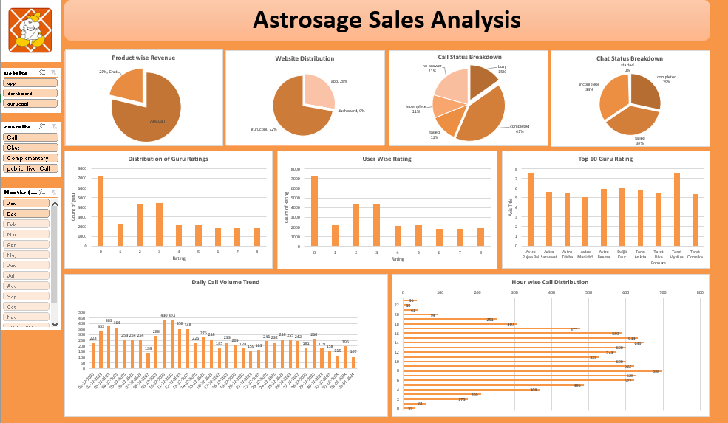

Slide 15
DASHBOARD KEY INSIGHTS
Boost App and Dashboard revenue by promoting features or discounts.
Investigate high Guru Rating 0 to address potential issues or enhance appeal.
Improve call completion rate (47%) with better scheduling or follow-ups.
Enhance chat success (only 20% completed) through training or tech upgrades.
Target peak call hours (10 AM-2 PM) for staffing or marketing efforts.
Encourage higher ratings (1-8) with incentives for gurus and users.

Slide 16
CONCLUSION
AstroSage faces challenges in call volume, customer satisfaction, and agent performance.
Immediate attention is needed to address these issues to remain competitive
Suggestions for Improvement Based on Findings
Agent Training:
Focus training on areas that correlate with high satisfaction, such as consultation effectiveness or reduced resolution time.
Optimization of Call Duration:
Identify the optimal duration range where satisfaction is highest and aim for efficiency within that range.
Feedback Integration:
Use customer feedback to identify pain points and success areas for iterative improvement.
Strategic Resource Allocation:
Deploy high-performing agents during critical time slots or for complex cases to maintain satisfaction levels.

Slide 17
THANK YOU

